Slide 1


Slide 2
Handling Navigation API
We use Navigations to perform forward ,back and refreshing the page we can also enter the URL of the application using to().

Slide 3
Example:
package monday;
import org.openqa.selenium.WebDriver;
import org.openqa.selenium.chrome.ChromeDriver;
public class NavigationAPI {
public static void main(String[] args) throws InterruptedException {
System.setProperty("webdriver.chrome.driver","./s/chromedriver.exe");
WebDriver driver=new ChromeDriver();
driver.navigate().to("https://www.facebook.com/");
driver.navigate().back();
driver.navigate().forward();
driver.navigate().refresh();
driver.close();
}}

Slide 4
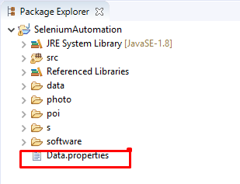
Handling Property file
All the data inside the property file should be stored in Key value pair
Structure:

Slide 5
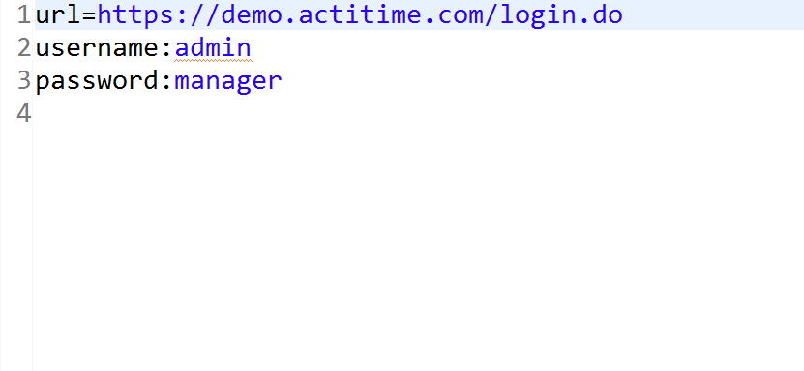
Property File

Slide 6
Eaxmple
package monday;
import java.io.FileInputStream;
import java.io.FileNotFoundException;
import java.io.IOException;
import java.util.Properties;
import java.util.concurrent.TimeUnit;
import org.openqa.selenium.By;
import org.openqa.selenium.WebDriver;
import org.openqa.selenium.chrome.ChromeDriver;

Slide 7
public class Demo {
public static void main(String[] args) throws FileNotFoundException, IOException, InterruptedException {
System.setProperty("webdriver.chrome.driver","./s/chromedriver.exe");
WebDriver driver=new ChromeDriver();
Properties p=new Properties();
p.load(new FileInputStream("./Data.properties"));
driver.get(p.getProperty("url"));
driver.manage().timeouts().implicitlyWait(10,TimeUnit.SECONDS);
driver.findElement(By.id("username")).sendKeys(p.getProperty("username"));
driver.findElement(By.name("pwd")).sendKeys(p.getProperty("password"));
driver.findElement(By.xpath("//div[.='Login ']")).click();
driver.close();
}}

Slide 8
Page Object Model(pom)
Page Object Model is a design pattern to create Object Repository for web UI elements. Under this model, for each web page in the application, there should be corresponding page class. This Page class will find the Web Elements of that web page and also contains Page methods which perform operations on those Web Elements.
If I want to achieve pom class Encapsulation is mandatory.
WHY POM
Duplication of Code
Less Time Consumption
Code Maintenance
Reformation of Automation Test Scripts
Syntax:
@FindBy(AN=‘AV’)
(private) access specifier WebElement Componentname;

Slide 9
Advantages of POM
Page Object Pattern says operations and flows in the UI should be separated from verification. This concept makes our code cleaner and easy to understand.
The Second benefit is the object repository is independent of test cases, so we can use the same object repository for a different purpose with different tools. For example, we can integrate POM with TestNG/JUnit for functional testing and at the same time with JBehave/Cucumber for acceptance testing.
Code becomes less and optimized because of the reusable page methods in the POM classes.
Methods get more realistic names which can be easily mapped with the operation happening in UI. i.e. if after clicking on the button we land on the home page, the method name will be like 'gotoHomePage()'.

Slide 10
Page Factory
Page factory is class provided by selenium web driver to support the page object design pattern. It makes handling “page objects” easier and optimized by providing the following-
@Findby annotation
Initelements method
1. Initelements()-
The initelements is a static method of pagefactory class which is used in conjunction with @findby annotation. Using the initelements method we can initialize all the web elements located by @findby annotation. Thus, instantiating the page classes easily
2.@Findby-
@Findby annotation is used in pagefactory to locate and declare web elements using different locators. Here, we pass the attribute used for locating the web element along with its value to the @findby annotation as parameter and then declare the element.

Slide 11
Example:
package monday;
import org.openqa.selenium.WebDriver;
import org.openqa.selenium.WebElement;
import org.openqa.selenium.support.FindBy;
import org.openqa.selenium.support.PageFactory;
public class Page {
@FindBy(xpath="//input[@name=\"firstname\"]")
private WebElement firstnametb;
Page(WebDriver driver)
{
PageFactory.initElements(driver,this);
}
public void firstname(String fn)
{
firstnametb.sendKeys(fn);
}
}

Slide 12
package monday;
import org.openqa.selenium.By;
import org.openqa.selenium.WebDriver;
import org.openqa.selenium.WebElement;
import org.openqa.selenium.chrome.ChromeDriver;

Slide 13
public class Test {
public static void main(String[] args) throws InterruptedException {
System.setProperty("webdriver.chrome.driver","./s/chromedriver.exe");
WebDriver driver=new ChromeDriver();
driver.get("https://www.facebook.com/");
Page p=new Page(driver);
driver.navigate().refresh();
p.firstname("johnhghdsghsdghgdhj");
driver.close();
}}

